Slide 1
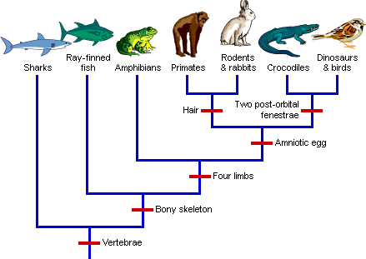
Evolutionary Trends
BIO 101
By
Alafia, A.O. (Ph.D)

Slide 2
Evolutionary trend
EVOLUTIONARY TREND
Can be defined as a persistent, directional change in a character state, or set of character states, resulting in a significant change through time.
Evolution means unrolling or unfolding. It is a process of gradual and orderly change from one condition to another. Such gradual and orderly changes are taking place in all the living, as well as non-living things.
EVOLUTION IS a scientific theory proposed by Charles Darwin. It occurs at the population level, It is made possible by genetic variations
Evolutionary trends can be determined by evaluating the amount of morphometric change per unit time.

Slide 3
Evolutionary trend
Evolutionary biology is a subfield of biology concerned with the study of the evolutionary processes that produced the diversity of life on Earth.
Evolutionary biologists study the descent of species, and the origin of new species.
EVIDENCES THAT SPECIES EVOLVE COMES FROM THREE LINES OF INVESTIGATION
Relationship were discerned among major groups of animals (Comparative anatomy)
Explorers discovered difference in the world distribution of species (Biogeography)
Geologist discovered apparent sequence of changing fossils in distinct layers of the earth

Slide 4
History of Life on Earth
BILLIONS OF YEARS AGO EXPLOSION OF DYING STARS RIPPED THROUGH OUR GALAXY AND LEFT BEHIND A DENSE CLOUD OF DUST AND GAS
AS THE CLOUD COOLED
There are scientific evidence that earth and the other planets of the solar system formed about 4.6 billion years ago.
Evidences have shown that conditions on early Earth made the origin of life possible e.g is the fossils of microorganisms that are about 3.5 billion years old.
There are approximately two million species of animals and plants living today,
How did this diversity of life come to exist?

Slide 5
According to doctrine of organic evolution, the present living objects on the earth have descended from the early simpler organisms by the process of gradual modifications and changes.
Evolution may be progressive or retrogressive.
Progressive evolution means that simpler forms of organisms moves towards becoming more complex structural and physiological organizations.
Retrogressive evolution can also occur when structurally more complex organic forms produce simpler individuals.
Examples of retrogressive evolution in plants includes
Derivation of fungi from algal ancestors as a result of loss of chlorophyll,
The development of structurally simplified types of flowers from more elaborate and more complex flowers
Change from autotropic nature to parasitic mode of nutrition in parasitic Cuscuta due to loss of chlorophyll

Slide 6
The modern concept of organic evolution
The theory suggest that the living world has undergone vast modification in the remote past, it is changing and presumably it will go on changing in the future
The evolution in the past has resulted different types of organisms among which many have become extinct and many are still existing
Evolution yields new groups of plants and animals, advances very slowly and requires millions of years to produce new taxa
Evolution proceeds either on progressive or on retrogressive lines. Both these processes of evolution are proceeding simultaneously in nature

Slide 7
LEVELS OF EVOLUTION
There are two levels of evolution
Microevolution
Macroevolution
Microevolution- changes in allele frequencies in a population over generations, it occurs at the genetic level. Small scale changes.
What causes allele frequency to change
Natural selection
Genetic drift – chance events that alters allele frequencies
Gene flow – the transfer of alleles between populations.
Only natural selection can cause ADAPTIVE RADIATION

Slide 8
LEVELS OF EVOLUTION
Macroevolution-Larger changes, such as when a new species is formed. It includes the idea that all life forms is connected and can be traced back to one common ancestor.
Macroevolution is cumulative microevolution
The sweeping changes in life on Earth revealed by fossils illustrates MACROEVOLUTION

Slide 9
The process of evolution can be summarized in three sentences:
Genes mutate.
Individuals are selected.
Populations evolve.
Note: individuals do not evolve but populations evolve e.g Biston betularia (English moth), Geospiza fortis.

Slide 10
Evolution
Evolution can be viewed in two related but different ways
As a pattern
As a process
One way to assess whether natural selection or other factors are causing evolution at a particular locus is to determine what the genetic makeup of a population would be if it were not evolving at that locus, and then compare with the real scenario. If there are no difference we can conclude that the real population is not evolving.

Slide 11
ORIGIN OF SPECIES: Mode of Speciation
A species is a group of populations whose members have the potential to interbreed in nature and produce viable, fertile offspring
There are two types of speciation: allopatric and sympatric speciation.
The two differ in geographical distribution of the populations in question.
Allopatric speciation is the most common form of speciation. It occurs when a population is split into two (or more) geographically isolated subdivisions that organisms cannot bridge. Eventually, the two populations' gene pools change independently until they could not interbreed even if they were brought back together. In other words, they have speciated.
.

Slide 12
ORIGIN OF SPECIES
Sympatric speciation occurs when two subpopulations become reproductively isolated without first becoming geographically isolated.
Insects that live on a single host plant provide a model for sympatric speciation. If a group of insects switched host plants they would not breed with other members of their species still living on their former host plant. The two subpopulations could diverge and speciate.
. Agricultural records show that a strain of the apple maggot fly Rhagolettis pomenella began infesting apples in the 1860's. Formerly it had only infested hawthorn fruit.

Slide 13
ORIGIN OF SPECIES
Speciation has been observed. In the plant genus Tragopogon, two new species have evolved within the past 50-60 years. They are T. mirus and T. miscellus. The new species were formed when one diploid species fertilized a different diploid species and produced a tetraploid offspring. This tetraploid offspring could not fertilize or be fertilized by either of its two parent species types. It is reproductively isolated, the definition of a species.

Slide 14
Factors that promote sympatric speciation
1. Polyploidy
2. Habitat differentiation
3. Sexual selection

Slide 15
Extinction
Extinction is the ultimate fate of all species.
The reasons for extinction are numerous.
A species can be competitively excluded by a closely related species, the habitat a species lives in can disappear and/or the organisms that the species exploits could come up with an unbeatable defense.

Slide 16
HISTORY OF EARTH
Geologic records has told us that Earths time can be divided into three Eons,
The first two Eons – the Archean and Protoezoic together lasted approximately 4 billion years. The Phanerozoic eon, the last half billion years ago encompasses most of the time that animals have existed on earth.
It is divided into three Eras : the Paleozoic, Mesozoic and Cenozoic.
Each era represents a distinct age in history of Earth and its life.
The first evidence of life dates back to 3.5 billion yaers ago and the record comes from fossilized stromatolites, formed by Prokayotes

Slide 17
Evolutionary trends in ANIMALS
1. Trends in Symmetry
2. Trends in Digestive Tracts
3. Trends in Body Cavities
4. Trends in Cephalization
5. Trends in Segmentation
6. Trends in Skeletal modification

Slide 18
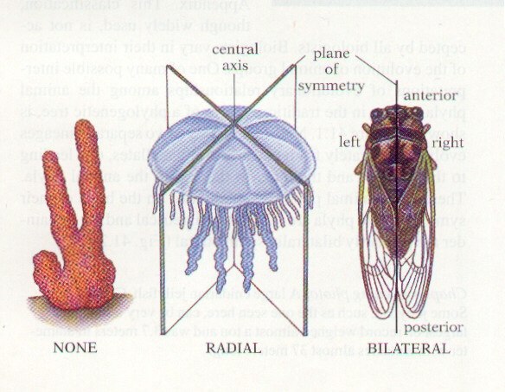
EVOLTUTIONARY TREND IN SYMMETRY
Asymmetry ( No Symmetry )
Radial Symmetry
Bilateral Symmetry

Slide 19
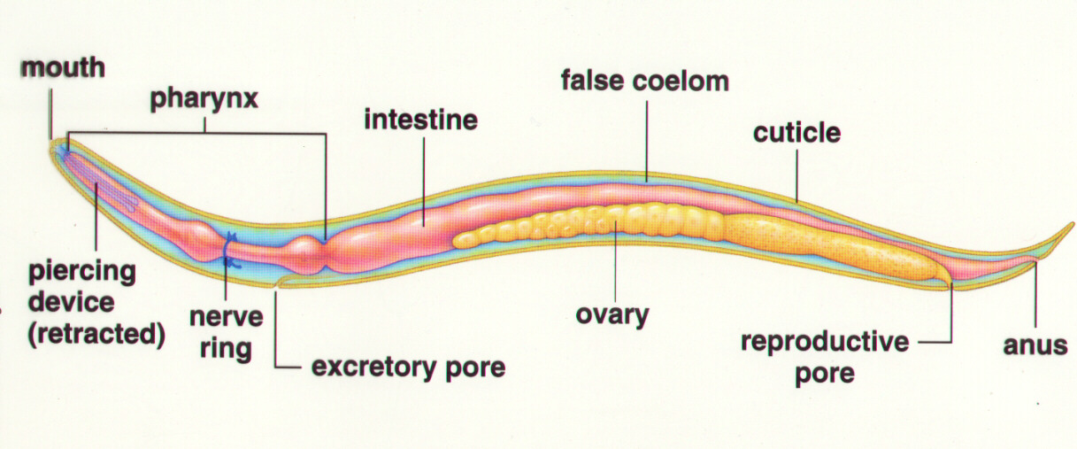
Digestive system complete
Incomplete
Complete

Slide 20
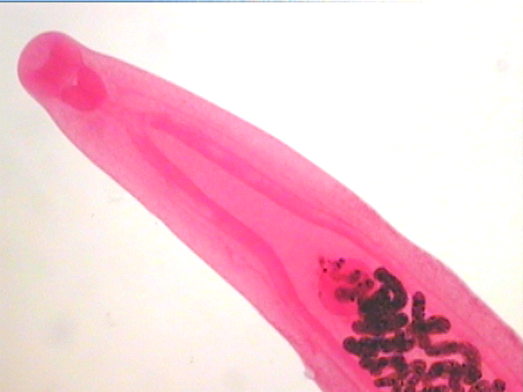
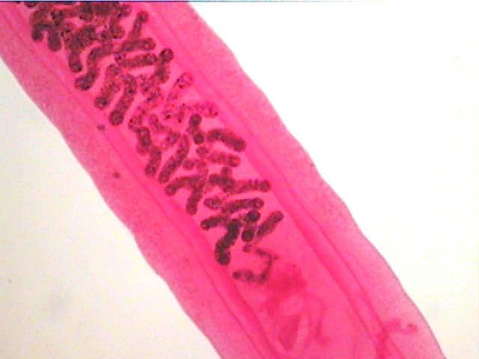
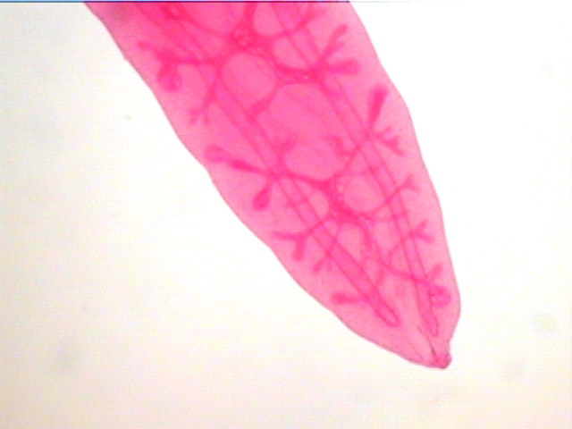
Incomplete

Slide 21
Evolutionary Trend in Body cavity
Acoelom (No Coelom )e.g platyhelminthes Flatworms
Pseudocoelom (False Body Cavity) e.g Round worm (Ascaris)
Coelom (True Coelom) e.g Earthworm

Slide 22
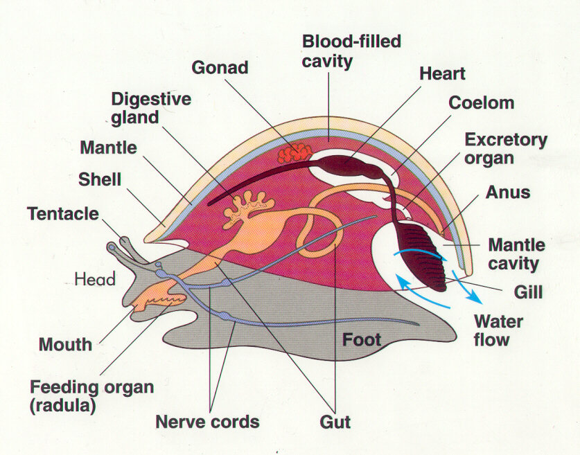
Advantages of coelom and psuedocoelom
The reproductive and digestive organs can evolve more complex shapes and functions.
The gut tube and other organs are cushioned and thus better protected.
Can act as hydroskeleton providing support and rigidity for the soft animal.
The activities of the suspended gut can take place undisturbed by the activity of the animal’s outer

Slide 23
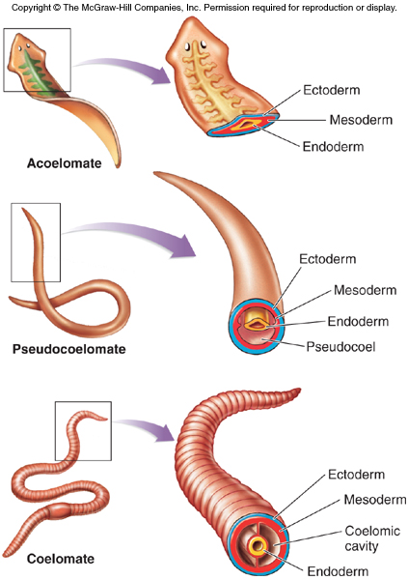

Slide 24
EVOLUTIONARY TREND IN CEPHALIZATION
Cephalization is considered an evolutionary trend, whereby nervous tissue, over many generations, becomes concentrated toward one end of an organism.
This process eventually produces a head region with sensory organs.

Slide 25
Protostomes or “First Mouth Animals”
During their embryonic development the mouth forms first and the anus second.
Deuterostomes: “Second Mouth Animals”
During their embryonic development the anus forms first and the mouth second.

Slide 26
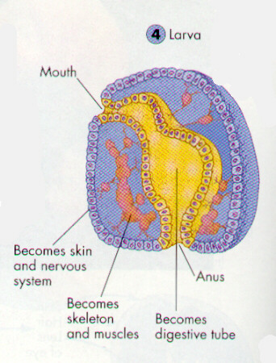
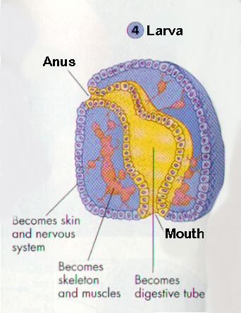
Larva
Deuterostome
Protostome

Slide 27
Evolutionary Trend in Segmentation
Segmentation in biology refers to the division of some animal and plant body plans into a series of repetitive segments.
i. this similar repeated units permit larger organisms
ii. in annelids (segmented worms), segments are similar
-- form fluid filled compartments that can be stretched or compressed separately-- worm locomotion
iii. segmentation permits specialization of different segments

Slide 28
Evolutionary Trend in SKELETAL MODIFICATION
TREND AMONG PRIMATE
FROM LEGGED GAITS TO SPECIALIZED MODE OF LOCOMOTION E.G BIPEDALISM (TWO LEGGED GAIT)
CHANGES IN THE SHOULDERS, BACKBONE, PELVIC GIRDLE, LEGS AND
CHANGE IN DENTITION
MODIFICATION OF HANDS LEADING TO INCREASED MANIPULATIVE SKILLS
LESS RELIANCE ON SENSE OF SMELL, MORE RELIANCE ON ENHANCED DAYTIME VISION
FROM SPECIALIZED TO OMNVOROUS EATING HABITS
BRAIN EXPANSION AND REORGANIZATION.- THIS TREND BEGAN WITHAMONG MAMMALS GENERALLY BUT ACCELERATED DURING HOMONID EVOLUTION

Slide 29
TREND IN BEHAIVOURAL MODIFICATION
LONGER LIFE SPAN
LONGER PERIODS BETWEEN PREGNANCY
SINGLE BIRTHS RATHER THAN LITTERS
EXTENDED PERIOD OF INFANCY DEPENDENCY

Slide 30
EVOLUTIONARY TRENDS IN PLANTS
Plants are thought to have evolved from an aquatic green alga protest, later they evolved important adaptations for land including vascular tissues, seeds and flowers.
The earliest plants were probably the stonewort an aquatic algae.
THEY HAD STALKS INSTEAD OF STIFF STEMS
HAIRLIKE RHIZOIDS INSTEADS OF ROOTS

